Slide 1


Company Profile
Percept Infosystem is an IT & Edu Tech company based in Nagpur offering services in the area of application development, web development, Training in IT and Non- IT Languages and Outsourcing.

Slide 2

Our Vision and Mission
Vision :
"Consistently deliver comprehensive and efficient software development solution and best services to the clients".
Mission :
"Skillfully applying the fast growing technology to help the clients to improve their business and grow together".

Slide 3
DEVELOPMENT
Percept Infosystem work in PHP. We have smart Wordpress developers who can integrate the designs and create the custom functionality.
We offer complete PHP Development Services and web programming services. we develop custom php web application, portals, ecommerce solution, business processes using php, MYSQL, MVC framework, open source cms like word press, joomla, magneto, etc.

Slide 4



Our Services
SOFTWARE DEVELOPMENT
RECRUITMENT SERVICE
Software development is the process of conceiving, specifying, designing, programming, documenting, testing, and bug fixing involved in creating and maintaining applications, frameworks, or other software components.
Recruitment is the overall process of identifying, sourcing, screening, shortlisting , and interviewing candidates for jobs .
We Percept Infosystem have Dedicated Placement Cell for Lifetime Recruitment Placement Support with a Network with leading Companies.
DIGITAL MARKETING SERVICES
We Percept Infosystem are committed to provide you the best solution in digital marketing, SEO, SMO and also best support in the industry.
We have expertise in Search Engine Optimization (SEO), Search engine marketing (SEM), Social Branding and online marketing solutions. Our online marketing strategies ensure the maximum exposure of your website.

Slide 5


SOFTWARE TRAINING
PAYROLL SERVICES
We customize the training needs of various corporate in Nagpur. It is my pleasure to introduce Percept Info system is renowned training provider, well known for providing quality Training in advance fields such as
PHP
Dot Net
Java
Software Testing
Digital Marketing
Web Designing
Graphic Designing
Android
Python
HR Training
Payroll Services offered by Percept Infosystem
Employee Management
Salary Management
Leave Management
PF/ESIC/PT returns
Calculating Paychecks and Tax Obligations based on Employee Time
Sheets.
Access to accurate and timely pay slips
Escalating cost due to in-house payroll maintenance
Security and confidentiality of payroll and employee data
Compliance with the latest laws and regulations
Access to accurate and timely pay slips
Escalating cost due to in-house payroll maintenance
Security and confidentiality of payroll and employee data
Compliance with the latest laws and regulations

Slide 6
TRAINING COURSE
PHP
.NET
Java
Software Testing
Digital Marketing
Web Designing
Graphic Designing
Android
Auto CAD
Catia
Python
HR Training

Slide 7

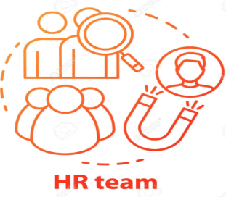
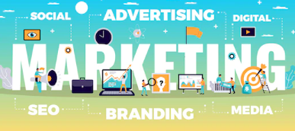
OUR TEAM
IT Team
Software Developers Manager
Software Developer Trainees
Software Developer Interns
HR Team
HR Manager
HR Recruiter
HR Interns
HR Trainees
Digital Marketing
Digital Marketing Interns
Digital Marketing Trainees

Slide 8
Placements:
Dedicated Placement Cell for Lifetime
Placement Support with a Network with
leading IT Companies.

Slide 9













OUR CLIENTS

Slide 10














Slide 11
Why Join Us
Organized pre-placement /training /Workshops/ Seminars for students.
We operate with the shared values of integrity, quality and accountability in everything we do.
We have well trained, reliable, Experienced professionals; with capacity to deliver on commitments, rapid responsiveness to resource needs and great sense of urgency there b resulting into cost effective pricing for our customer.

Slide 12



Get In Touch
20/2, Akar Builders, Opp – Dalal Nursing home, Near Byramji town, Sadar, Nagpur.
Website: www.perceptinfosystem.com
Email: hr@perceptinfosystem.com
Ms. Pooja Bhosle Patil
8208970766
Mr. Rohit Patil
7414977373

